Slide 1
The Computer Network
A computer network is a group of computers/devices(Nodes) that use a set of common communication protocols over digital interconnections for the purpose of sharing resources located on or provided by the network nodes.
The nodes of a computer network may include personal computers, servers, networking hardware, or other specialised or general-purpose hosts.
The interconnections between nodes are formed from a broad spectrum of telecommunication network technologies, based on physically wired, optical, and wireless technologies.
A communication protocol is a set of rules for exchanging information over a network. physically wired, optical, and wireless

Slide 2
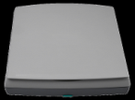




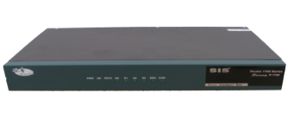
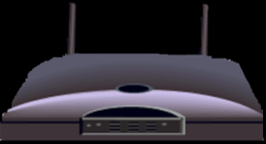
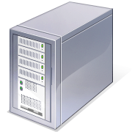

The Network Diagram
(Click on the Words Below and Learn More About Each Component)
Wired Network
PC
Firewall
The Internet
Fiber Optic Network Cable
Router
Switch
Server
Other LANS
Wireless Network
Notes:
I wanted to present this diagram to help the viewer visually understand how a computer network was set-up. I linked each component to the same text links throughout the project.

Slide 3
The Advantages/Uses of Network
Simultaneous Access
  There are moments in any business when several workers may need to use the same data at the same time.
Shared Peripheral Devices
Personal Communications
  Videoconferencing
  Voice over Internet Protocol (VoIP):-VoIP transmits the sound of voice over a computer network using the Internet Protocol (IP ) rather than sending the signal over traditional phone wires
Easier Data Backup

Slide 4
The Networking Devices(Nodes)
NIC Card
Repeater
Hub
Switch
Bridge
Router
Gateway
Firewall

Slide 5
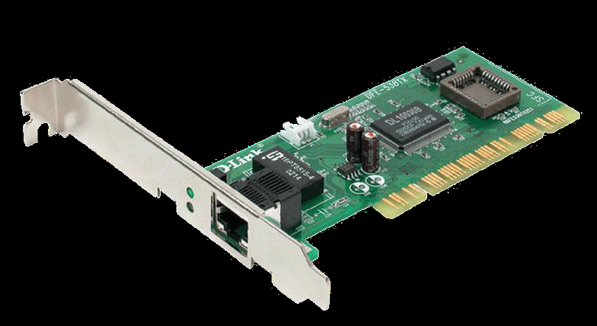
1. Network Interface Card
  NIC is used to physically connect host devices to the network media.
  A NIC is a printed circuit board that fits into the expansion slot of a bus on a computer motherboard.
  It can also be a peripheral device. NICs are sometimes called network adapters.
  Each NIC is identified by a unique code called a Media Access Control (MAC) address.
  This address is used to control data communication for the host on the network.
Notes:
Once again, I tried to pull graphics from the original network diagram. I had to alter the wireless router graphic in Photoshop to make it look better. I darken the and removed a white background to make it look consistent in relation to the standard router.

Slide 6
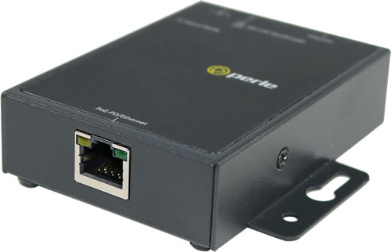
2. Repeaters
A repeater is a network device used to regenerate a signal.
Repeaters regenerate analog or digital signals that are distorted by transmission loss due to attenuation.
A repeater does not make an intelligent decision concerning forwarding packets
Notes:
Once again, I tried to pull graphics from the original network diagram. I had to alter the wireless router graphic in Photoshop to make it look better. I darken the and removed a white background to make it look consistent in relation to the standard router.

Slide 7
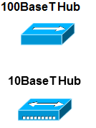
3. Hubs
Hubs concentrate on connections.
In other words, they take a group of hosts and allow the network to see them as a single unit. This is done passively, without any other effect on the data transmission.
Active hubs concentrate hosts and also regenerate signals.
Notes:
Once again, I tried to pull graphics from the original network diagram. I had to alter the wireless router graphic in Photoshop to make it look better. I darken the and removed a white background to make it look consistent in relation to the standard router.

Slide 8
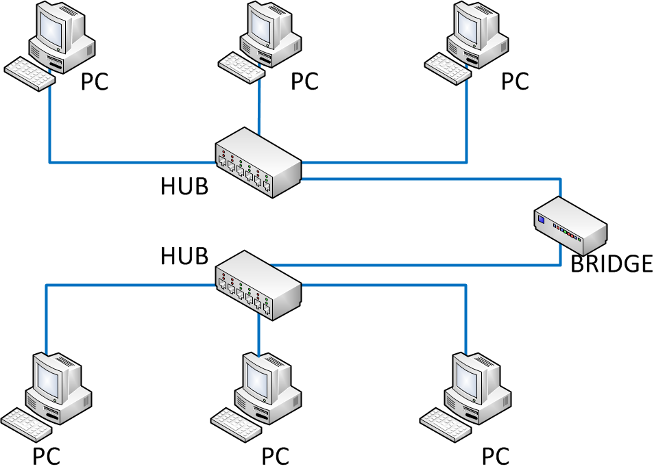
4. Bridges
Bridges convert network data formats and perform basic data transmission management.
Bridges provide connections between LANs.
They also check data to determine if it should cross the bridge. This makes each part of the network more efficient
Notes:
Once again, I tried to pull graphics from the original network diagram. I had to alter the wireless router graphic in Photoshop to make it look better. I darken the and removed a white background to make it look consistent in relation to the standard router.

Slide 9
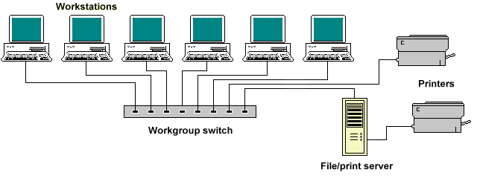
5. Switches
Switches add more intelligence to data transfer management.
They can determine if data should remain on a LAN and transfer data only to the connection that needs it.
Another difference between a bridge and switch is that a switch does not convert data transmission formats
Notes:
Once again, I tried to pull graphics from the original network diagram. I had to alter the wireless router graphic in Photoshop to make it look better. I darken the and removed a white background to make it look consistent in relation to the standard router.

Slide 10
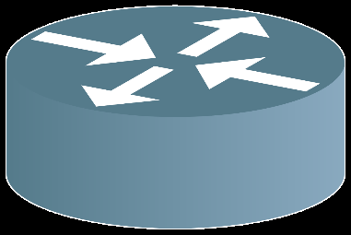
6. Routers
Routers have all the capabilities listed above.
Routers can regenerate signals, concentrate multiple connections, convert data transmission formats, and manage data transfers.
They can also connect to a WAN, which allows them to connect LANs that are separated by great distances.
Notes:
Once again, I tried to pull graphics from the original network diagram. I had to alter the wireless router graphic in Photoshop to make it look better. I darken the and removed a white background to make it look consistent in relation to the standard router.

Slide 11
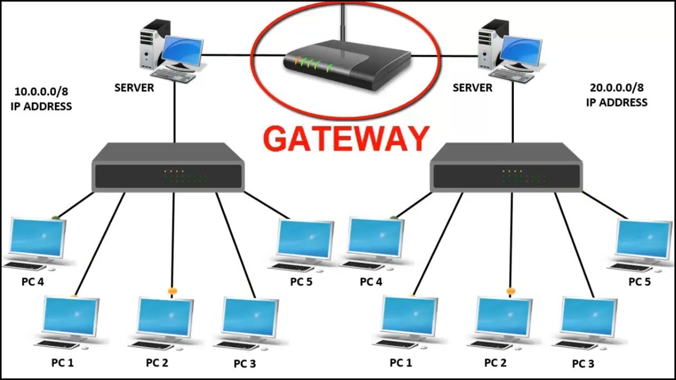
7. Gateway
A gateway is a piece of networking hardware used in telecommunications for telecommunications networks that allows data to flow from one discrete network to another.
Gateways are distinct from routers or switches in that they communicate using more than one protocol to connect a bunch of networks
Notes:
Once again, I tried to pull graphics from the original network diagram. I had to alter the wireless router graphic in Photoshop to make it look better. I darken the and removed a white background to make it look consistent in relation to the standard router.

Slide 12
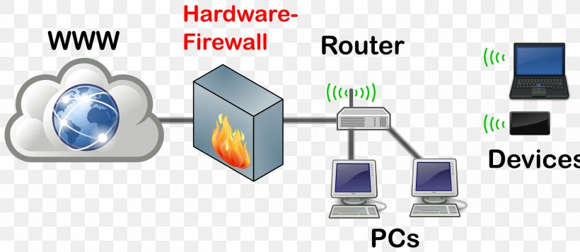
8. Firewall
A firewall is a network device or software for controlling network security and access rules.
Firewalls are inserted in connections between secure internal networks and potentially insecure external networks such as the Internet.
Firewalls are typically configured to reject access requests from unrecognized sources while allowing actions from recognized ones.
The vital role firewalls play in network security grows in parallel with the constant increase in cyber attacks.
Notes:
Once again, I tried to pull graphics from the original network diagram. I had to alter the wireless router graphic in Photoshop to make it look better. I darken the and removed a white background to make it look consistent in relation to the standard router.

Slide 14
Types of Networks
Personal Area Network (PAN)
Local Area Network (LAN)
Metropolitan Area Network (MAN)
Wide Area Network (WAN)
Notes:
I used this slide as a Introduction to the different types of networks. I tried to let the graphics do the talking on this slide. I elaborated more on each network type on subsequent slides.

Slide 15
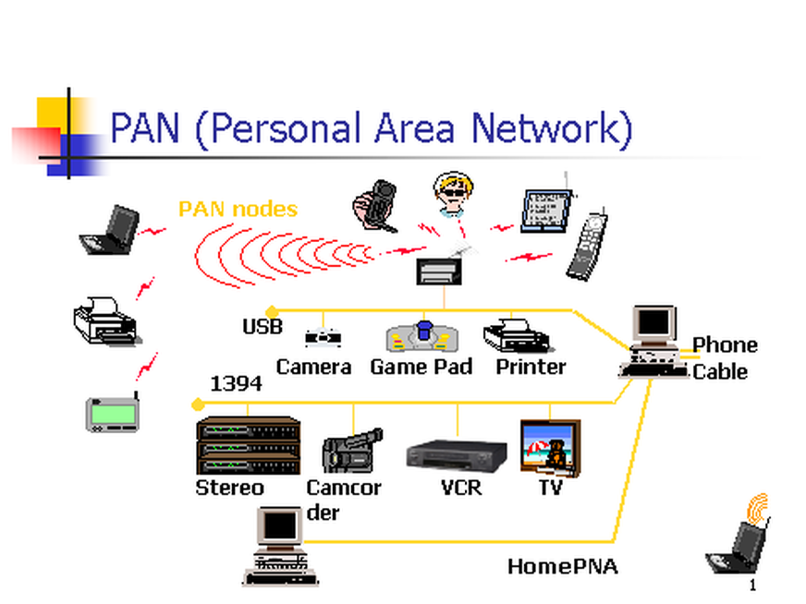
1. Personal Area Network
Personal Area Network (PAN) is a computer network used for data transmission amongst devices such as computers, telephones, tablets and personal digital assistants.
Also Known as HAN (Home Area Network)
PANs can be used for communication amongst the personal devices themselves (interpersonal communication), or for connecting to a higher level network and the Internet (an uplink) where one "master" device takes up the role as internet router.
Notes:
I kept the graphic the same as the previous graphic representing the Wide Area Network in hopes of creating a degree familiarity. I also include some basic facts about it.

Slide 16
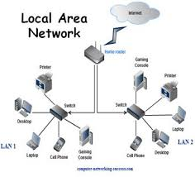
2. Local Area Network
LAN is a computer network covering small geographical area like home, office, or group of buildings
An upside of a LAN is fast data transfer with data speed that can reach up to 10Gbps.
Other significant LAN technologies are Fiber Distributed Data Interface (FDDI), Ethernet and token ring.
Notes:
I kept the graphic the same as the previous graphic representing the Local Area Network in hopes of creating a degree familiarity. I also include some basic facts about it.

Slide 17
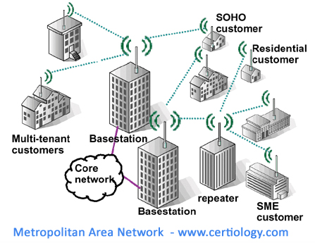
3. Metropolitan Area Network
A MAN is larger than a LAN but smaller than or equal in size to a WAN.
MAN spans a city or a large campus consists of two or more LANs
The size range anywhere from 5 to 50km in diameter.
MANs are typically owned and managed by a single entity.
Data transfer rate is higher than WAN but lower than LAN
Notes:
I kept the graphic the same as the previous graphic representing the Wide Area Network in hopes of creating a degree familiarity. I also include some basic facts about it.

Slide 18

4. Wide Area Network
A Wide Area Network exist over a large geographical area
Data travels through telephone or cable lines
The world’s largest Wide Area Network in the Internet
Notes:
I kept the graphic the same as the previous graphic representing the Wide Area Network in hopes of creating a degree familiarity. I also include some basic facts about it.

Slide 19
Network Topologies
Network topology defines the structure of the network.
Physical topology:- It define the actual layout of the wire or media.
  Bus
  Ring
  Star
  Tree(Hierarchical)
  Mesh
Logical topology:- It defines how the hosts access the media to send data.
  Broadcast
  Token passing
Hybrid Topology
Notes:
The topology section of my presentation may have been a little confusing for those who are not in the IT or networking field. I tried to explain the process and function of topologies using the three subsequent slides and the features of each topology.

Slide 20
1. Bus Topology
All devices are connected to a central cable, called bus or backbone.
There are terminators at each end of the bus that stops the signal and keeps it from traveling backwards.
T
T
Advantages:
There is no central controller.
Control resides in each station
The less interconnecting wire is required.
Ease of installation.
Backbone cable can be laid along the most efficient path, and then connected to the nodes by drop lines of various lengths
Disadvantages:
It is possible that more than one station may attempt transmission simultaneously (collision or contention).
Difficult reconfiguration and fault isolation.
A fault or break in the bus cable stops all transmission, even between devices on the same side of the problem.
The damaged area reflects signals in the direction of origin, creating noise in both directions
Notes:
I wanted to beak each of these down so it could be explained and understood better. While topology diagrams can be easily understood in the IT field they may be a little hard to grasp to average person.

Slide 21
2. Ring Topology
All devices are connected to one another in the shape of a closed loop.
Each device is connected directly to two other devices, one on either side of it.
Advantages:
Avoids the collisions that are possible in the bus topology.
Each pair of stations has a point-to-point connection.
A signal is passed along the ring in one direction, from device to another, until it reaches its destination.
Each device incorporates a repeater.
Relatively easy to install and reconfigure.
Fault isolation is simplified.
Disadvantages:
A break in the ring (such as station disabled) can disable the entire network.
Unidirectional traffic.
Notes:
I wanted to beak each of these down so it could be explained and understood better. While topology diagrams can be easily understood in the IT field they may be a little hard to grasp to average person.

Slide 22
3. Star Topology
All devices are connected to a central hub.
Nodes communicate across the network by passing data
through the hub or switch.
Advantages:
  1. Easy to install and reconfigure.
  2. Robustness, if one link fails; only that link is affected. All other links remain active.
  3. Easy fault identification and isolation. As long as the hub is working, it can be used to monitor link problems and bypass defective links.
Disadvantages:
  1. The devices are not linked to each other.
  2. If one device wants to send data to another, it sends it to the controller, which then relays the data to the other connected device.
Notes:
I wanted to beak each of these down so it could be explained and understood better. While topology diagrams can be easily understood in the IT field they may be a little hard to grasp to average person.

Slide 23
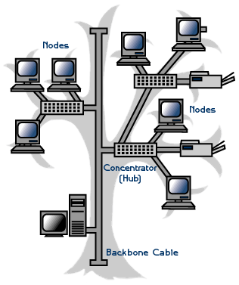
4. Tree/Hierarchical Topology
Advantages:
It allows more devices to be attached to a single central hub and can therefore increase the distance a signal can travel between devices.
It allows the network to isolate and prioritize communications from different computers.
Disadvantages:
The devices are not linked to each other.
If one device wants to send data to another, it sends it to the controller, which then relays the data to the other connected device.
The addition of secondary hubs brings two further advantages.
Notes:
I wanted to beak each of these down so it could be explained and understood better. While topology diagrams can be easily understood in the IT field they may be a little hard to grasp to average person.

Slide 24
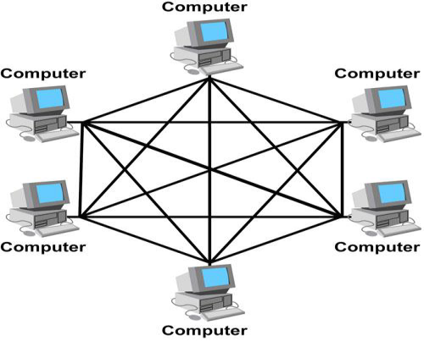
6. Mesh Topology
Each host has its connections to all other hosts.
Mesh topology is implemented to provide as much protection as possible from interruption of service.
A nuclear power plant might use a mesh topology in the networked control systems.
Although the Internet has multiple paths to any one location, it does not adopt the full mesh topology.
Advantages:
1. The use of dedicated links guarantees that each connection can carry its data load, thus eliminating the traffic problems that can occur when links must be shared by multiple devices.
2. It is robust, if one link becomes unusable, it does not incapacitate (affect) the entire system.
3. Privacy and Security (every message sent travels along a dedicated line; only the intended recipient sees it).
4. Point-to-point links make fault identification and fault isolation easy.
Disadvantages:
1. A large amount of cabling required.
2. A large amount of I/O ports required.
3. Installation and reconfiguration are difficult.
4. The sheer bulk of the wiring can be greater than the available space (in the walls, ceiling, or floors) can accommodate.
5. The hardware required to connect each link (I/O ports and cables) can be prohibitively expensive.
Notes:
I wanted to beak each of these down so it could be explained and understood better. While topology diagrams can be easily understood in the IT field they may be a little hard to grasp to average person.

Slide 25
Transmission Media
A transmission medium is a physical path between the source and the destination i.e. it is the channel through which data is sent from one place to another
The function of the media is to carry a flow of information through a LAN.
There are two types of transmission media
(1) Guided Media
(2) Unguided Media
Guided Media:
It is also referred to as Wired or Bounded transmission media. Here there is physical link between source and destination.
There are three types of Guided Media: (1) Twisted Pair Cable
(2) Coaxial Cable
(3) Optical Fiber Cable
.
Notes:
Once again, I tried to pull graphics from the original network diagram. I had to alter the wireless router graphic in Photoshop to make it look better. I darken the and removed a white background to make it look consistent in relation to the standard router.

Slide 26
Transmission Media
Unguided Media: This also referred to as Wireless or Unbounded transmission media. No physical medium is required for the transmission of electromagnetic signals. It uses the atmosphere, or space, as the medium
Different unguided media are (1) Radio waves
(2) Microwaves
(3) Infrared
Some points:
Twisted pair cable and coaxial cable are made of copper. The disadvantage of sending data over copper wire is that the further the signal travels, the weaker it becomes.
Guided transmission media is good for short distance where as unguided transmission media is good for large distance.
Guided transmission media is more secure than unguided transmission media.
Notes:
Once again, I tried to pull graphics from the original network diagram. I had to alter the wireless router graphic in Photoshop to make it look better. I darken the and removed a white background to make it look consistent in relation to the standard router.

Slide 27
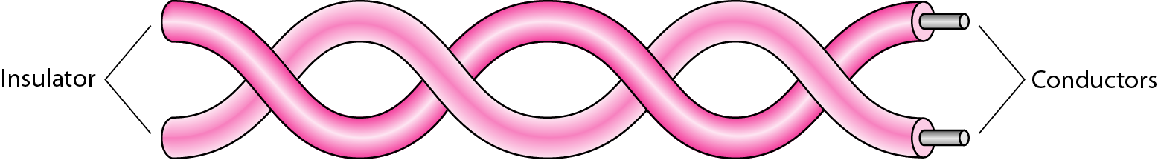
Twisted Pair Cable
It is the most used transmission media. It consists of 2 separately insulated conductor wires wound about each other. Generally, several such pairs are bundled together in a protective sheath.
Twisted pair cables are used in LAN and Telephone networks.
RJ45 connector is used for twisted pair cables.
There are two types of twisted pair cables
(1) Shielded Twisted Pair (STP)
(2) Unshielded Twisted Pair (UTP)
.
Notes:
Once again, I tried to pull graphics from the original network diagram. I had to alter the wireless router graphic in Photoshop to make it look better. I darken the and removed a white background to make it look consistent in relation to the standard router.

Slide 28
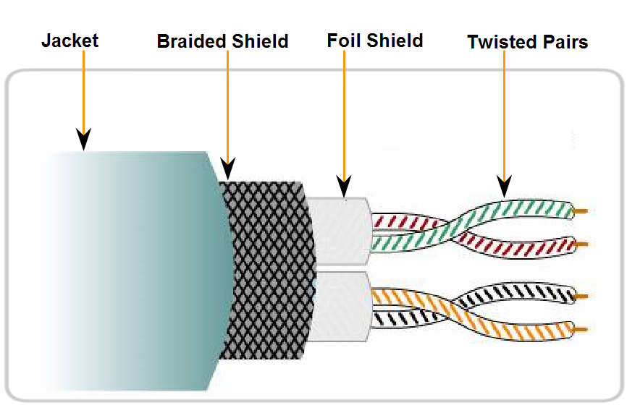
Shielded Twisted Pair(STP)
Speed: 0-100Mbps
Cost: Moderate
Media and connector size: Medium to large
Maximum cable length: 100m
Metal sheath covers each pair.
Notes:
Once again, I tried to pull graphics from the original network diagram. I had to alter the wireless router graphic in Photoshop to make it look better. I darken the and removed a white background to make it look consistent in relation to the standard router.

Slide 29
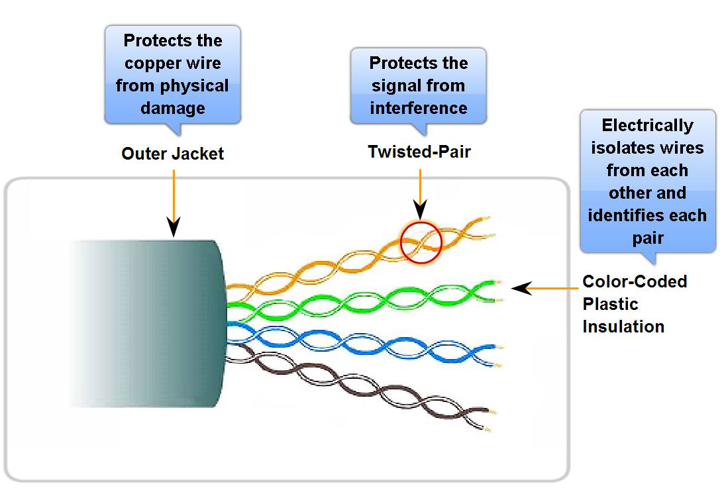
Unshielded Twisted Pair
UTP is a four-pair wire medium used in a variety of networks.
Each of the eight copper wires in the UTP cable is covered by insulating material
Speed: 10-1000 Mbps*
Cost: Least Expensive
Easy to install
Maximum cable length: 100m * (Depending on the quality/category of cable)
Notes:
Once again, I tried to pull graphics from the original network diagram. I had to alter the wireless router graphic in Photoshop to make it look better. I darken the and removed a white background to make it look consistent in relation to the standard router.

Slide 30
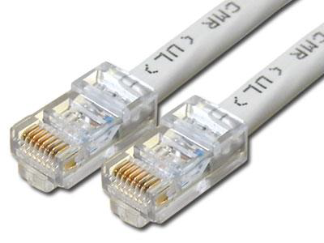
UTP Connector
EIA/TIA specifies an RJ-45 connector for UTP cable.
The letters RJ stand for registered jack.

Slide 31

Coaxial Cable
It can be run longer distances than Twisted pair Cables.
Coaxial cable has two concentric copper conductors (inner conductor and outer conductor.)
The outer conductor in coaxial cable make it less susceptible to noise.
It has higher bandwidth than twisted pair cable
  Speed: 10-100Mbps
  • Cost: Inexpensive
  • Media and connector size: Medium
  • Maximum cable length: 500m
  The connector used is BNC Connector.
Notes:
Once again, I tried to pull graphics from the original network diagram. I had to alter the wireless router graphic in Photoshop to make it look better. I darken the and removed a white background to make it look consistent in relation to the standard router.

Slide 32
Fiber Optic Cable
It transmits signal in the form of lights
It has 3 parts
  (1) Core
  (2) Cladding
  (3) Jacket
Cladding acts as dielectric insulator
Repeater spacing : 40 km
Optical fiber uses FDM
Optical fiber is used for long distance communication
Optical fiber is immunity to electromagnetic interfaces due to presence of jackets.
It is lighter than copper cables.
It has high bandwidth and attenuation.
Installation and maintenance is very high.
It is very expensive and unidirectional propagation.
The connectors are SC – Connector and ST-Connector

Slide 33
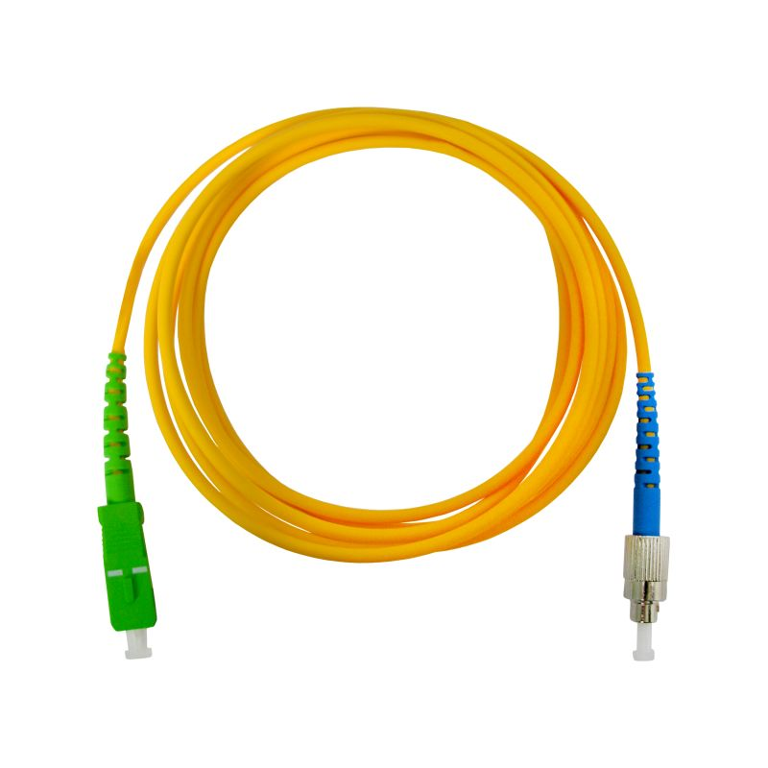
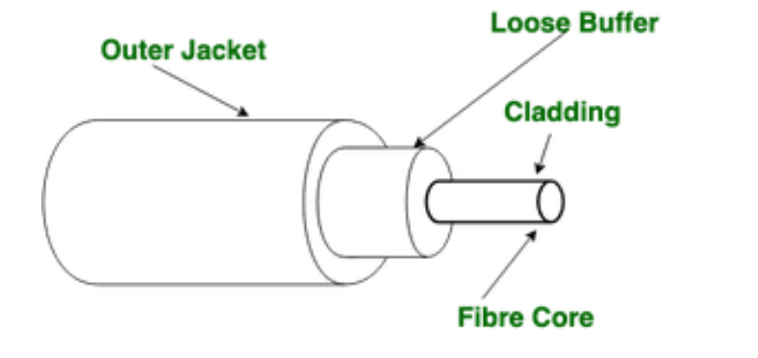
Fiber Optic Cable
It uses the concept of refraction of light through a core made up of glass or plastic. The core is surrounded by a less dense glass or plastic covering called the cladding. It is used for the transmission of large volumes of data.

